Slide 1
CHAPTER 2: CHEMICAL REACTIONS
2-2: Classifying chemical reactions

Slide 2
Types of Chemical Reactions
All chemical reactions can be grouped into Categories:
Synthesis
Decomposition
Replacement
Single
Double
What does synthesis mean?
What does decomposition mean?
What does replacement mean?

Slide 3
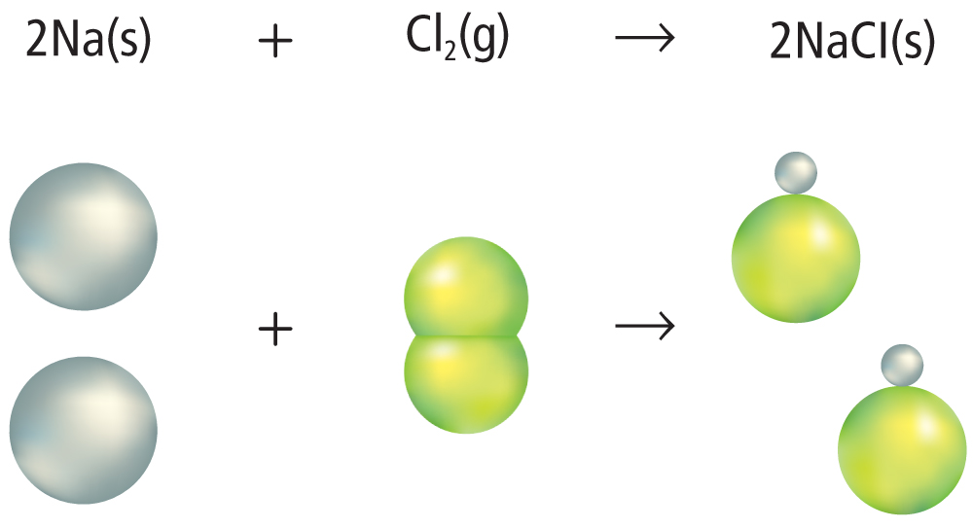
Synthesis Reactions
Example:
A synthesis reaction is a reaction in which two or more elements or compounds combine to make a more complex substance.

Slide 4
Synthesis Reactions
All synthesis reactions follow this general equation:
A + B → AB

Slide 5
Decomposition Reactions
Example:
A decomposition reaction is one in which a single compound breaks down into two or more elements or new compounds.

Slide 6
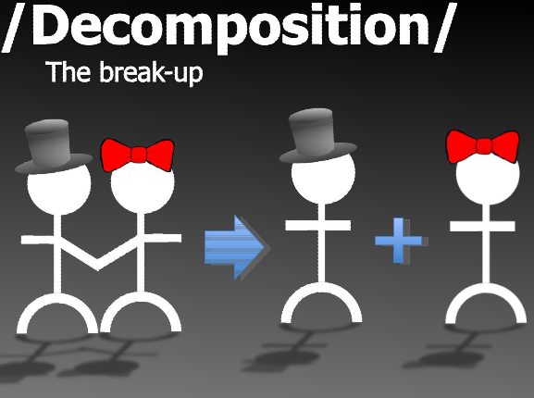
Decomposition Reactions
Decomposition reactions follow this general equation:
AB → A + B

Slide 7
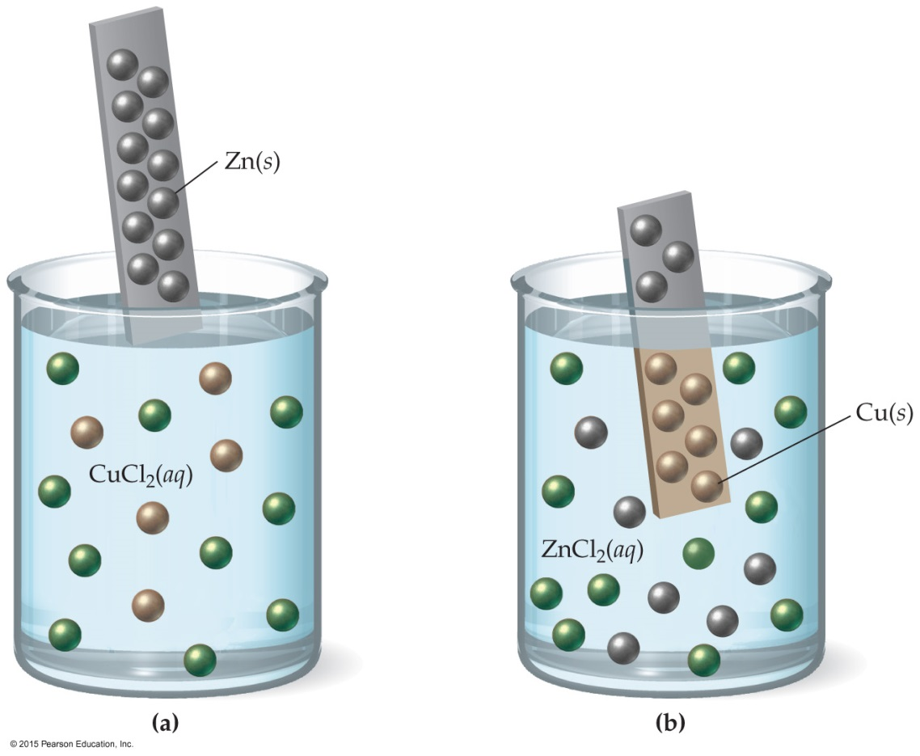
Single Replacement Reactions
Example:
In a single-replacement reaction, one element replaces another in a compound.

Slide 8
Single Replacement Reactions
Usually follow this general equation:
A + BC → AC + B
Also called single-displacement

Slide 9
Double Replacement Reactions
Example:
Double replacement reactions occur when ions exchange between two compounds.

Slide 10
Double Replacement Reactions
Usually follows the general equation:
AB + CD → AD + BC
Also called double-displacement

Slide 11
Practice
Classify the following reactions:
Na₂O(s) + H₂O(l) ⟶ 2 NaOH(aq)
Ba(NO₃)₂(aq) + K₂SO₄(aq) ⟶ BaSO₄(s) + 2 KNO₃(aq)

Slide 12
Practice
2 Al(s) + Fe₂O₃(s) ⟶ Al₂O₃(s) + 2 Fe(l)
2 H₂O₂(aq) ⟶ 2 H₂O(l) + O₂(g)

