Slide 1
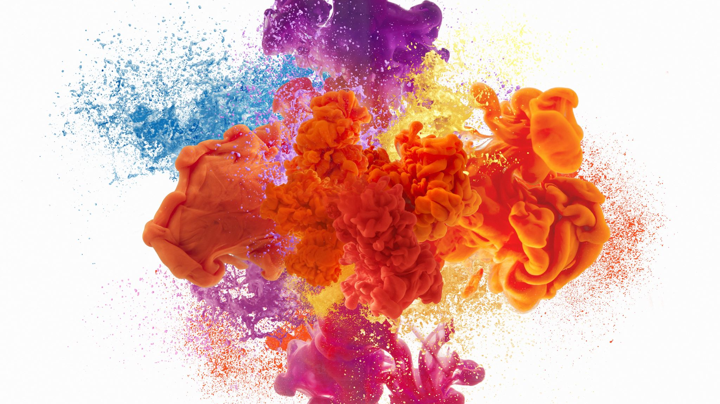
Mixtures
Chapter 1 Section 1

Slide 2
Pure Substances
Has a specific composition and specific set of properties
Every sample has the same ratio of atoms
Example:
Elements (Hydrogen)
Compounds (H₂0)
H₂O

Slide 3
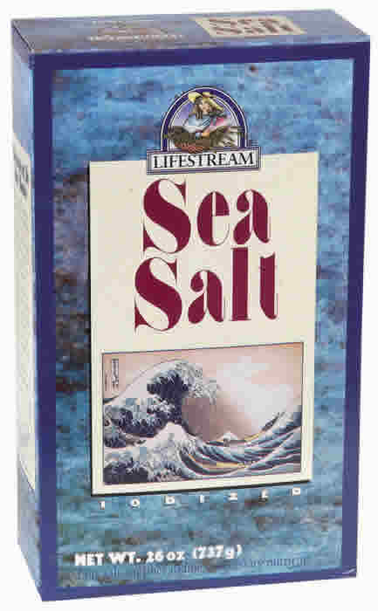
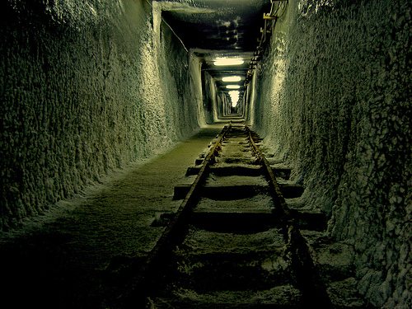
Pure Substances: Salt
Evaporated Sea Salt
Underground Sea Salt
NaCl
NaCl
1:1
1:1
Crystal
Clear/White
Melts at 801ºC
Crystal
Clear/White
Melts at 801ºC

Slide 4
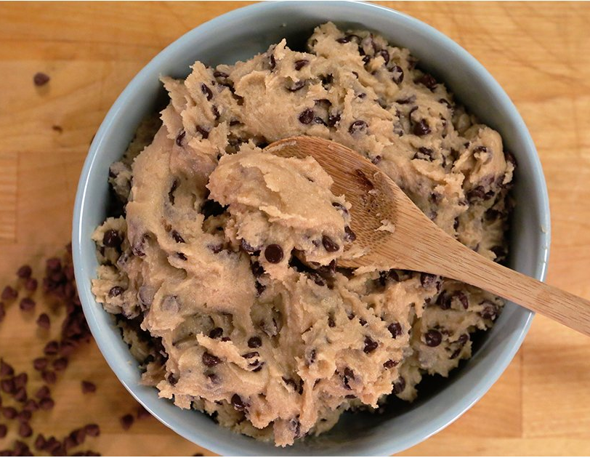
Mixtures
Most things in the world are not pure, instead they are mixtures
Matter made of two or more pure substances that are not chemically combined

Slide 5
Mixtures
Usually easy to separate into its components
Each pure substance in a mixture keeps its own properties
The parts of a mixture are not combined in a set ratio

Slide 6
Separating Mixtures
Mixtures can easily be separated by magnetic attraction, filtration, distillation, and evaporation.
Activity
How could you separate the mixture of sand and iron?

Slide 7
Two Types of Mixtures: Heterogeneous
You can see the different parts
Example: Soil and cookie Dough

Slide 8
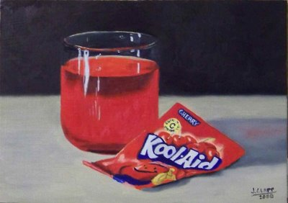
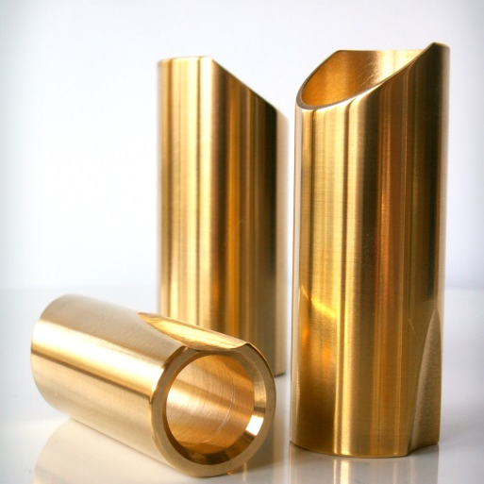
Two Types of Mixtures: Homogeneous
Evenly mixed so that you can’t see the different parts (uniform)
A solution
Example:
Sugar dissolving in water
Nitrogen dissolving in oxygen
Copper dissolving in zinc (Brass)

Slide 9
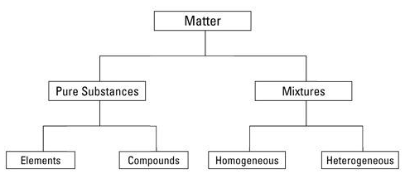

Slide 10
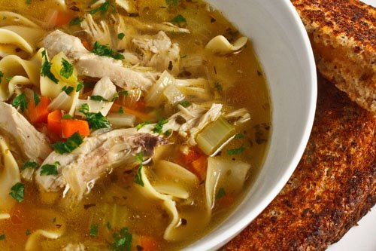
What’s what? Pure Substance or Homogeneous Mixture or Heterogeneous Mixture
Chicken soup

Slide 11
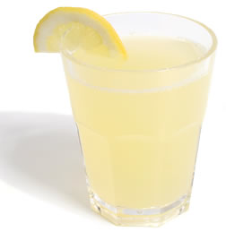
What’s what? Pure Substance or Homogeneous Mixture or Heterogeneous Mixture
Chicken soup
Lemonade

Slide 12
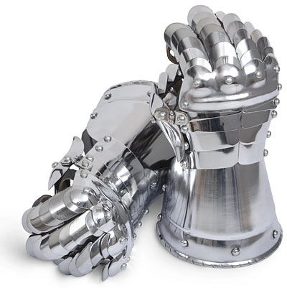
What’s what? Pure Substance or Homogeneous Mixture or Heterogeneous Mixture
Chicken soup
Steel

Slide 13
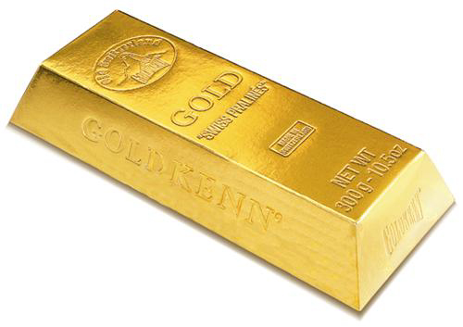
What’s what? Pure Substance or Homogeneous Mixture or Heterogeneous Mixture
Chicken soup
Gold

Slide 14
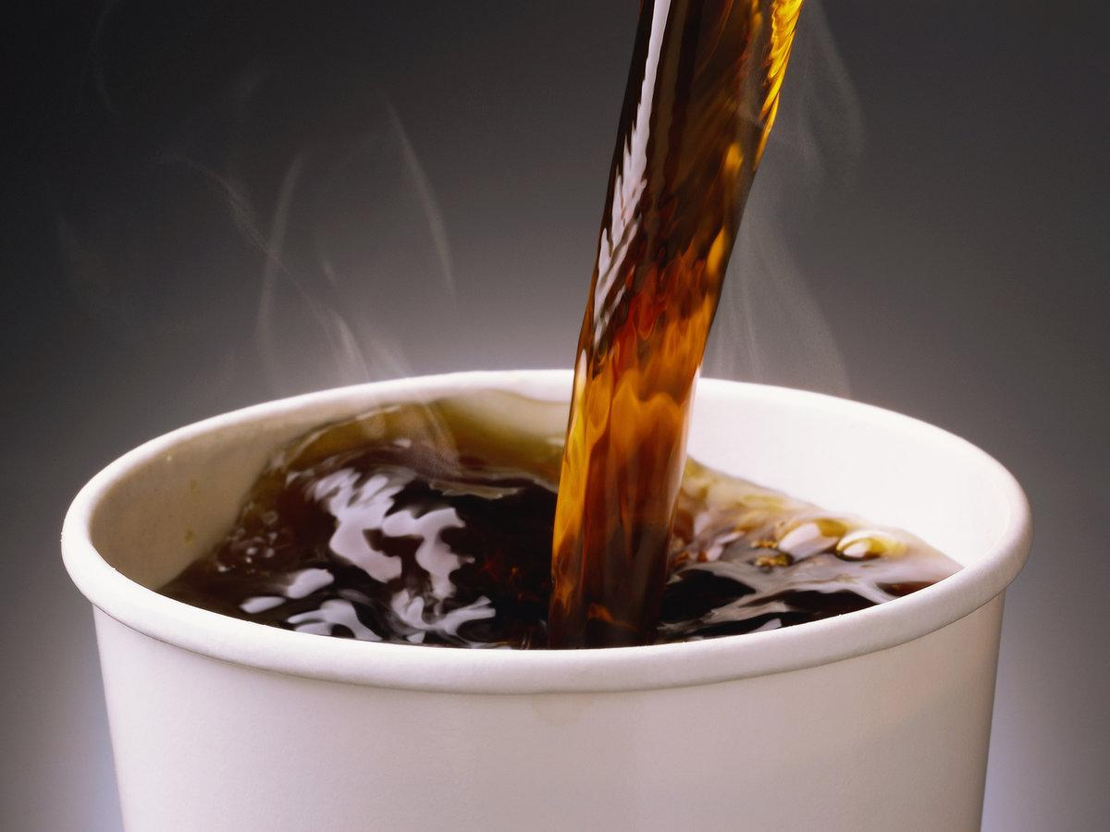
What’s what? Pure Substance or Homogeneous Mixture or Heterogeneous Mixture
Chicken soup
Coffee

Slide 15
What’s what? Pure Substance or Homogeneous Mixture or Heterogeneous Mixture
Chicken soup
Blood

Slide 16
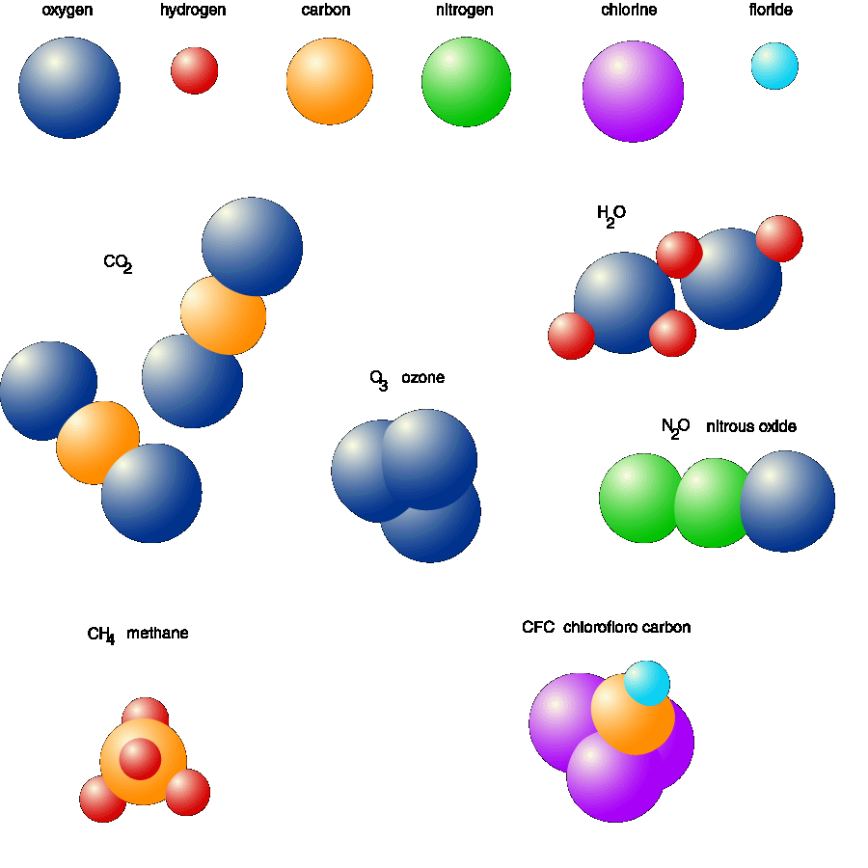
What’s what? Pure Substance or Homogeneous Mixture or Heterogeneous Mixture
Air

Slide 17
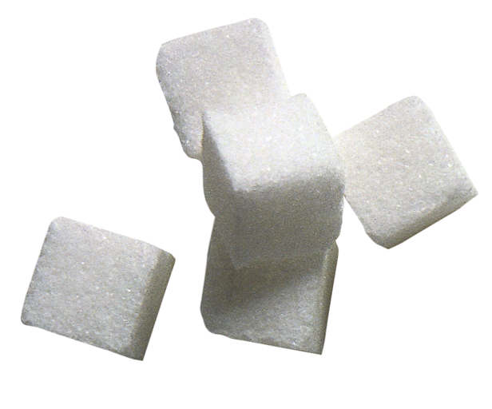
What’s what? Pure Substance or Homogeneous Mixture or Heterogeneous Mixture
Chicken soup
Sugar

Slide 18
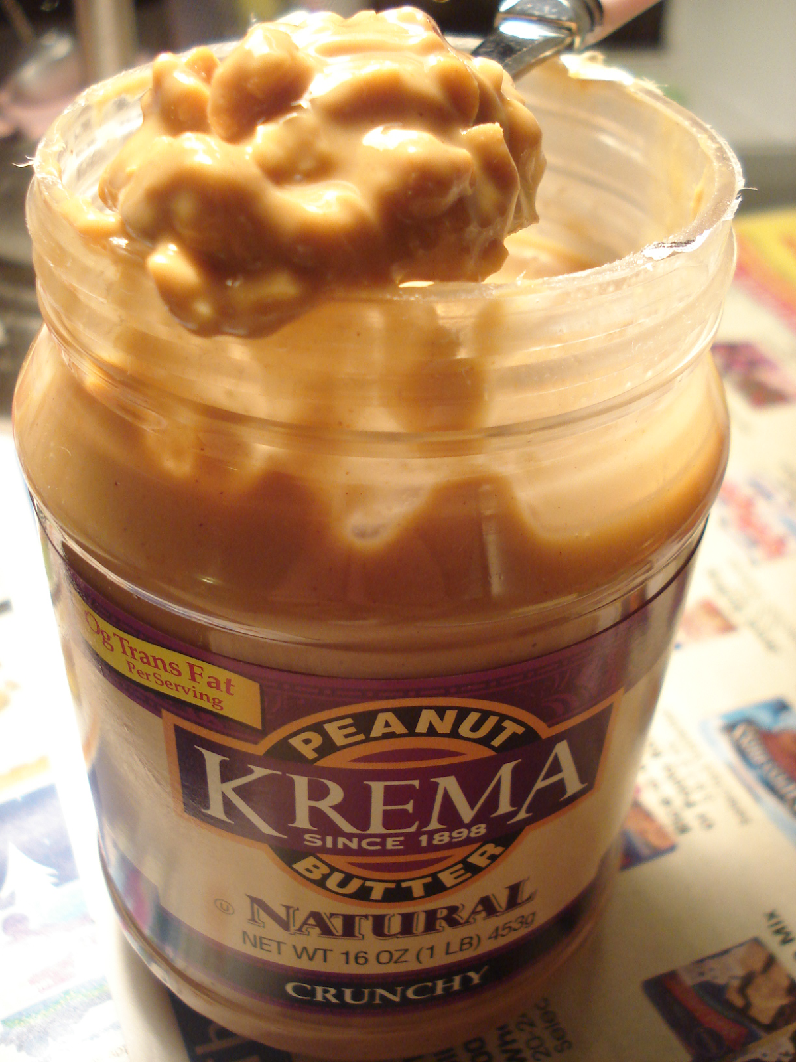
What’s what? Pure Substance or Homogeneous Mixture or Heterogeneous Mixture
Chunky Peanut Butter
Chicken soup

