Slide 1
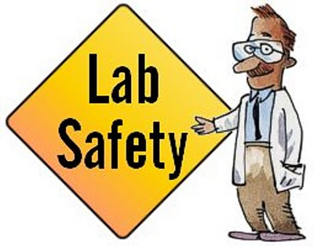
A lesson in
A science lab is a place where many exciting things can happen. It is also a place with dangerous materials and potential hazards. Following sensible safety precautions will help to ensure that your experience in the lab is a positive one.

Slide 2
General lab safety rules
Do not work in the lab unless Miss Falk is present, and always obtain Miss Falk’s permission before beginning any experiment.

Slide 3
General lab safety rules
Keep lab stations clear of all non-laboratory materials

Slide 4
General lab safety rules
No open-toe shoes, loose clothing, or dangling jewelry is allowed. Long hair must be tied back.

Slide 5
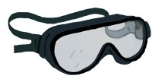
General lab safety rules
Use the safety equipment provided for you. Goggles should be worn when using chemicals or sharp objects.

Slide 6
General lab safety rules
Never run or become involved in horseplay.

Slide 7
General lab safety rules
Do not eat or drink while in the lab. Never use any lab equipment as food or drink containers.

Slide 8
General lab safety rules
Do not inhale, taste, or touch any chemicals unless specifically told to do so by Miss Falk.

Slide 9
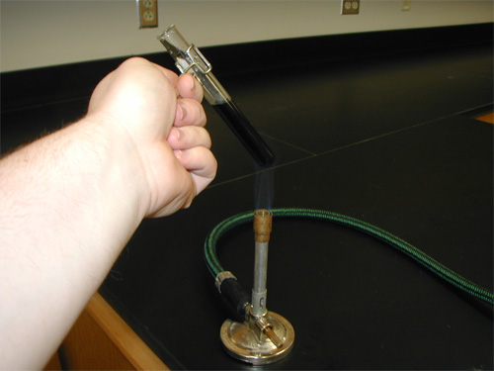
General lab safety rules
Always slant test tubes away from yourself and others when heating them.

Slide 10
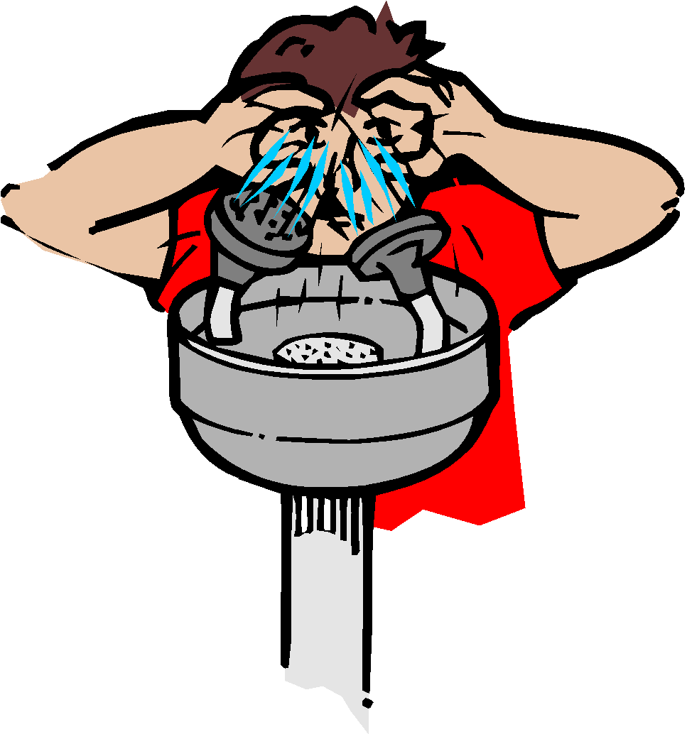
General lab safety rules
Know the location and proper use of the fire blanket, fire extinguisher, fire alarm, eye wash station, first aid kit, and emergency shut offs.

Slide 11
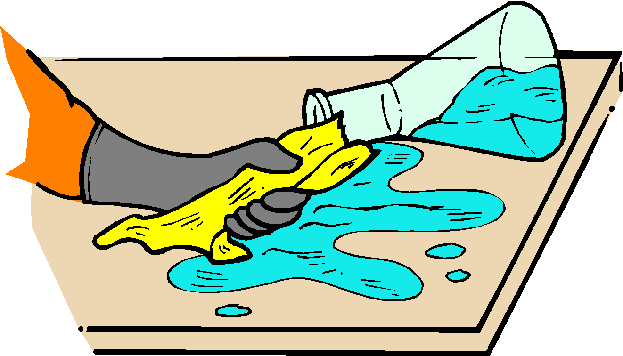
General lab safety rules
Report any accident or injury, no matter how small, to the instructor.

Slide 12
General lab safety rules
Discard liquids and solids as indicated by Miss Falk.

Slide 13
General lab safety rules
Never take anything from the lab unless given permission by Miss Falk.

Slide 14
Any Questions

